Slide 1
Linux coursework
Abdihamid Mohamed Moallim

Slide 2
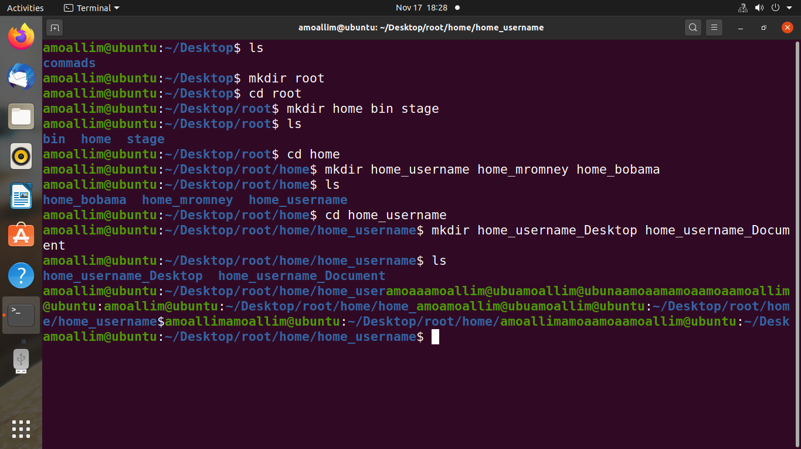
In part one of the coursework was creating a directories and subdirectories So I used mkdir command

Slide 3
Part two

Slide 4
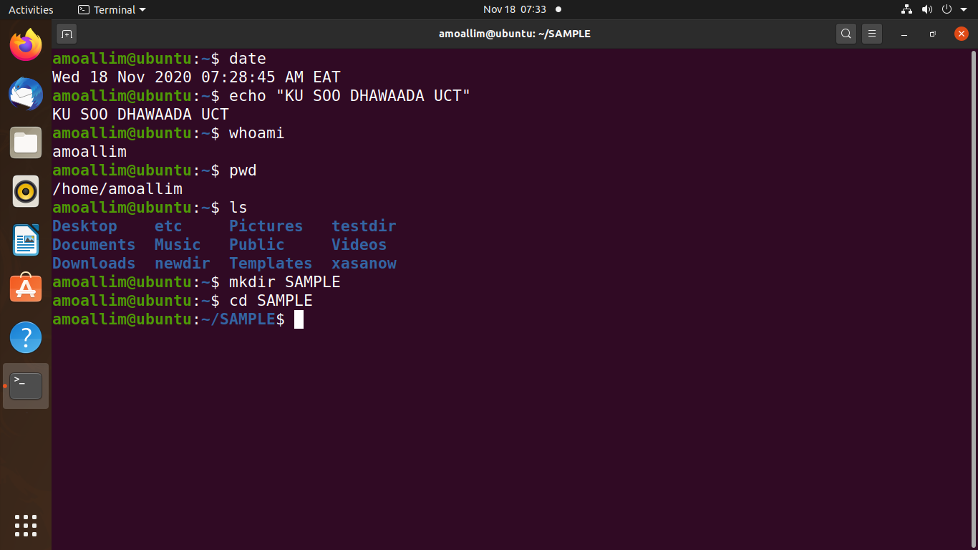
1. I used date command to Display the Current Date and Current Time. 2. I used echo command to Display the message “KU SOO DHOWAADA UCT” in enlarged characters. 3. pwd command to Display the name of your home directory. 4. I used Mkdir command to Create a directory SAMPLE under your home directory

Slide 5
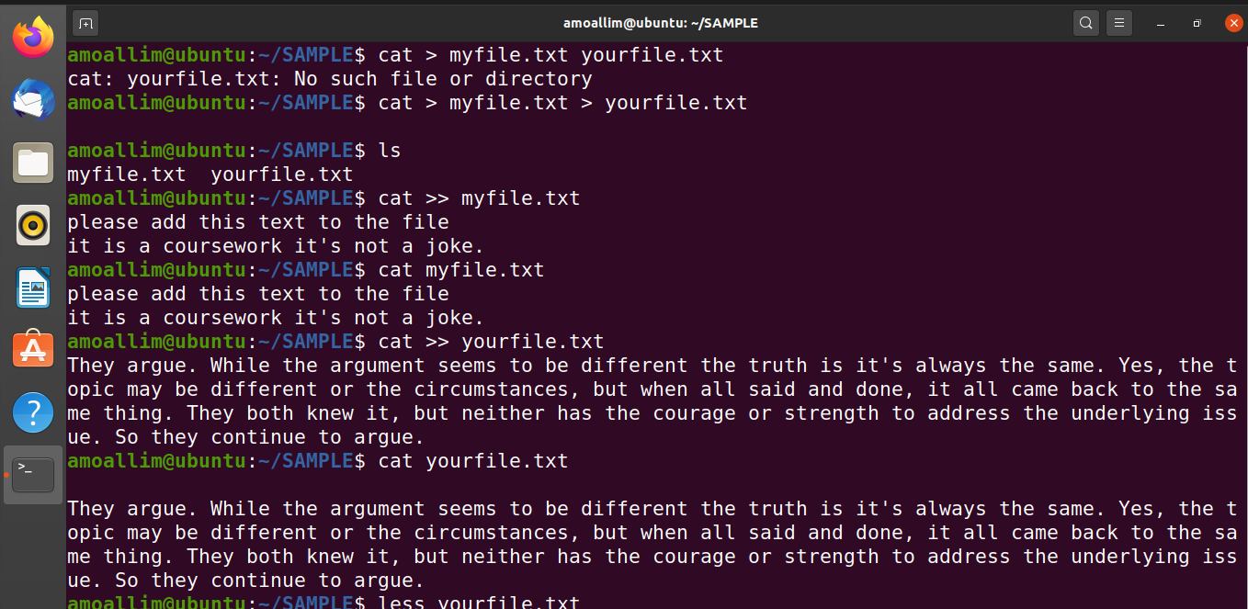
5 . Using cd command to go inside the directory that I created in questions four (SAMPLE) Since cat is multipurpose I used to create and to write a text in a file (s)

Slide 6
Question 5 : continued
5 .I used cat > command to Create files myfile and yourfile although cat > myfile.txt yourfile.txt didn’t work but cat > myfile.txt > yourfile.txt works really fine 6 .Then I used cat >> filename.txt to Append more lines in the myfile.txt and yourfile.txt files

Slide 7
7. Ls commad lists or shows what is inside a directory (folder)
8. If ls added –r ( ls –r ) lists in reverse in other word it shows you the contents in Z to A way
9. cd.. Command means go back one step in other word go to the parent directory of the current directory
10. cd../.. Command means go to the root directory

Slide 8
11. I used sudo groupadd –g id_name group_name
Sudo to get permition
Groupadd the command to create a group
-g is an option
The numerical value of the group's ID. This value must be unique, unless the -o option is used.
The value must be non-negative. The default is to use the smallest ID value greater than or
equal to GID_MIN and greater than every other group.
source :<< http://manpages.ubuntu.com/manpages/bionic/man8/groupadd.8.html >>
group id e.g: 1010

Slide 9
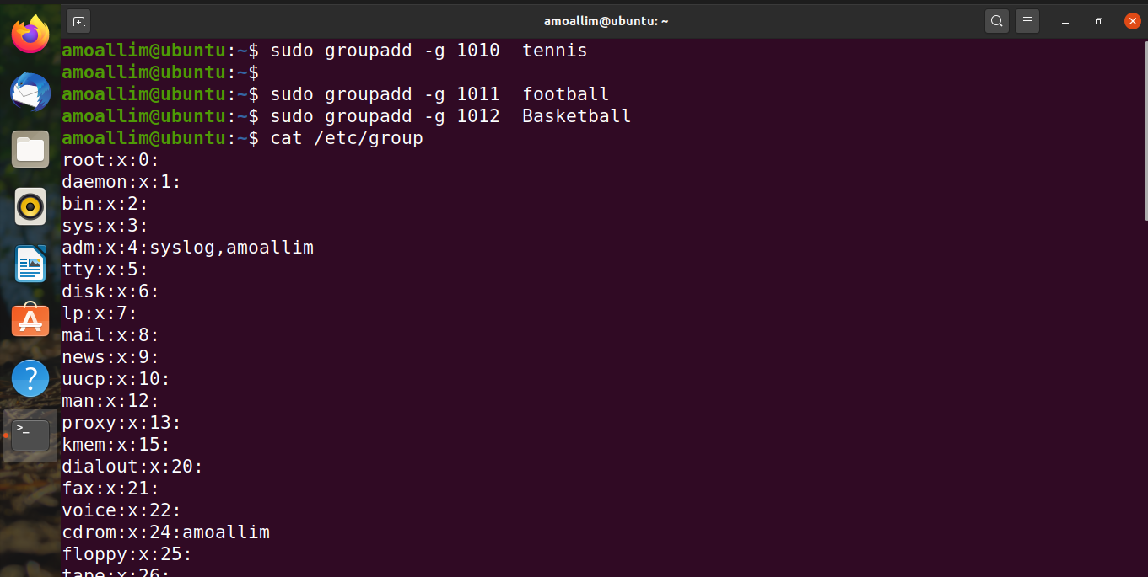

Slide 10
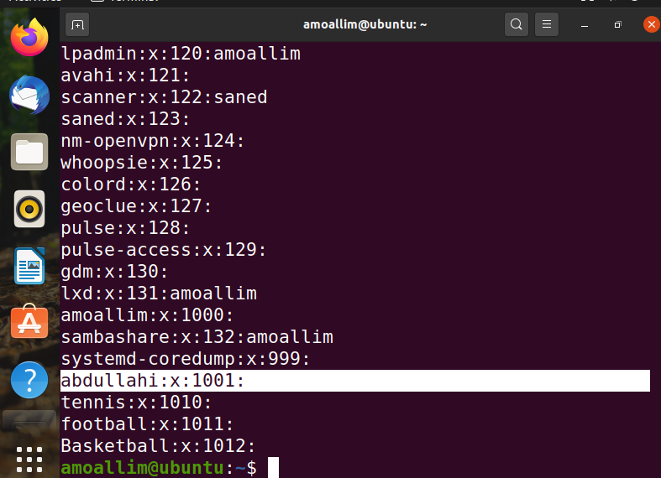
I used cat /etc/group see the last command in the previous picture
And see the result in the picture below

Slide 11
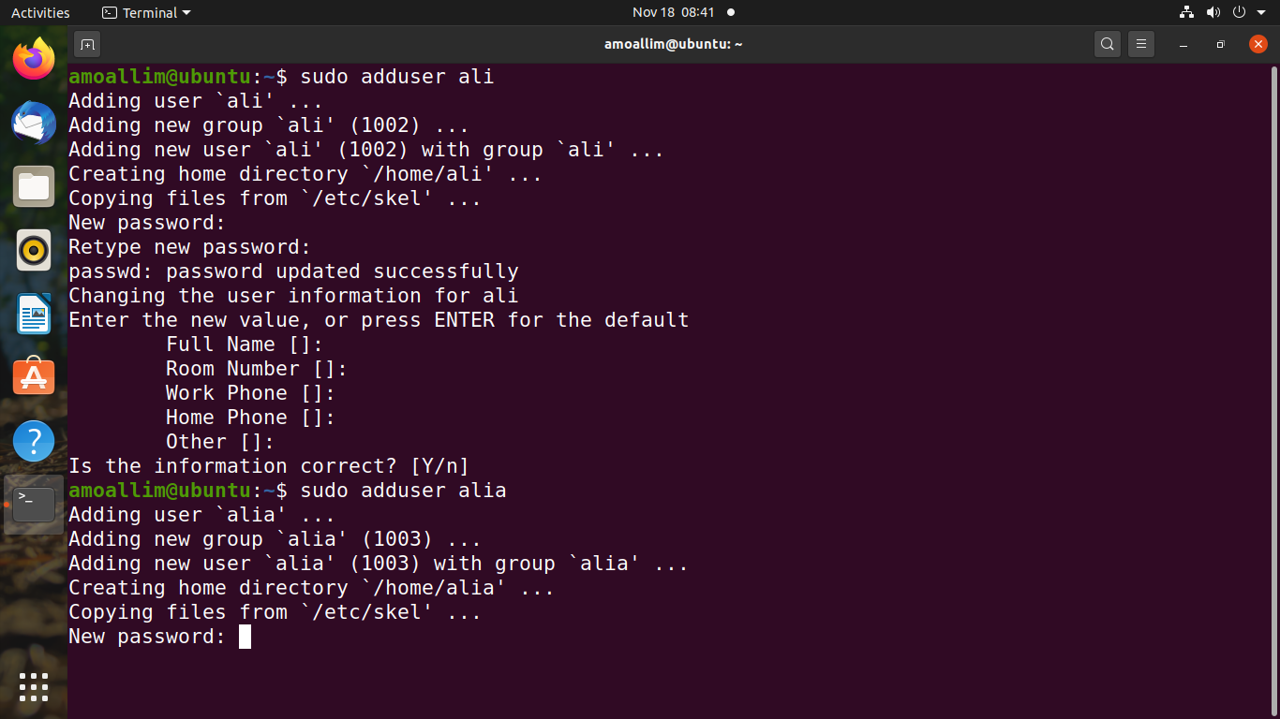
12. I used sudo adduser user_name to add new user
In this case :
sudo adduser ali
sudo adduser alia

Slide 12
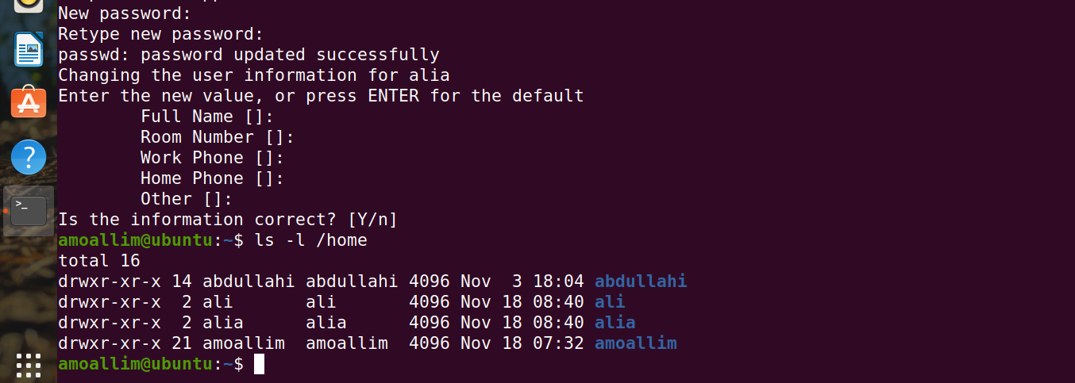
Here is the result and I used ls –l /home to see if the users are created or not

Slide 13
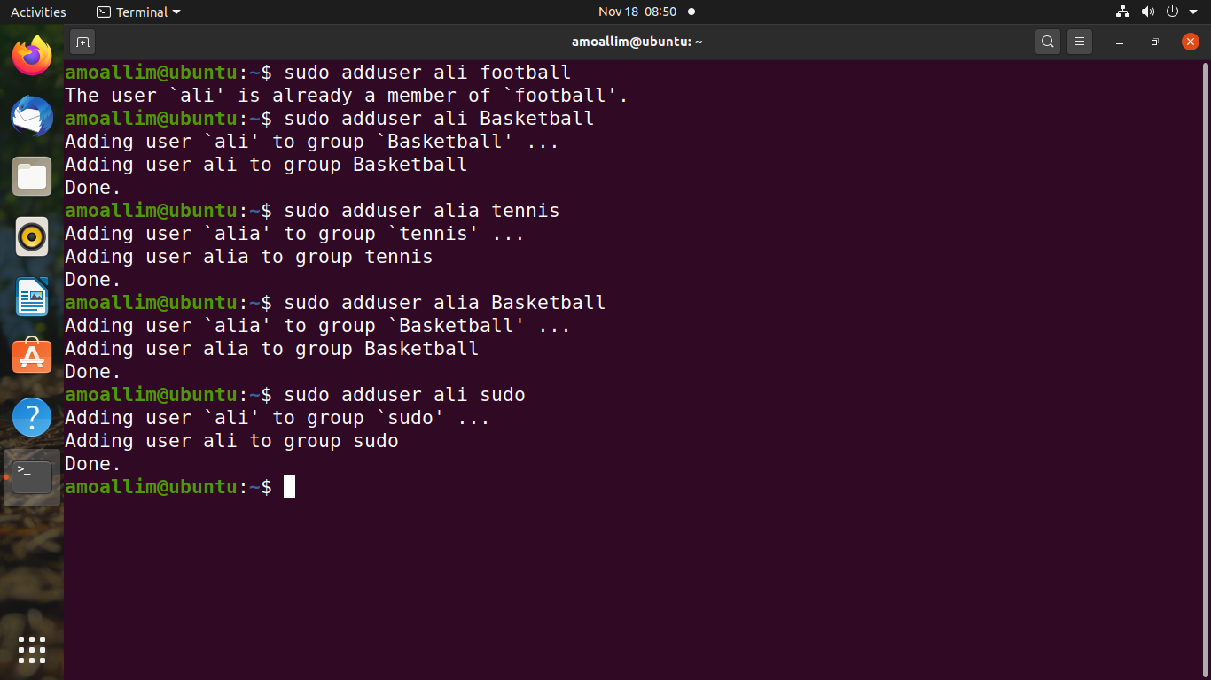
To 15 : used sudo adduser user_name group_name command to add a user to a group

Slide 14
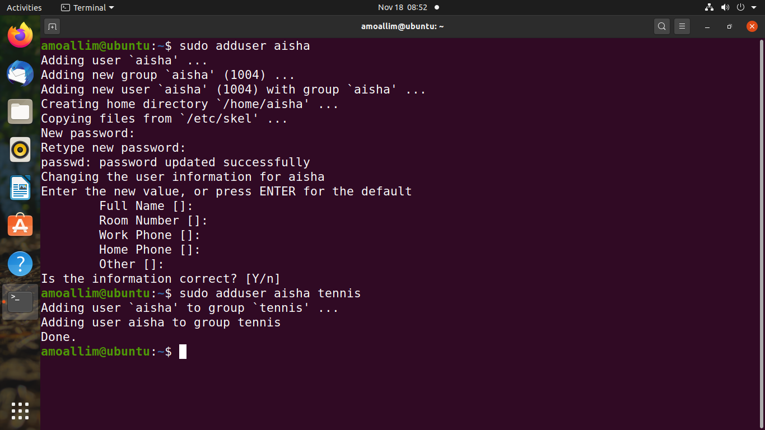
16. Same as question 12 I used sudo adduser user_name to create a user account named aisha
And then Used sudo adduser aisha tennis to add aisha user to a group called tennis

Slide 15
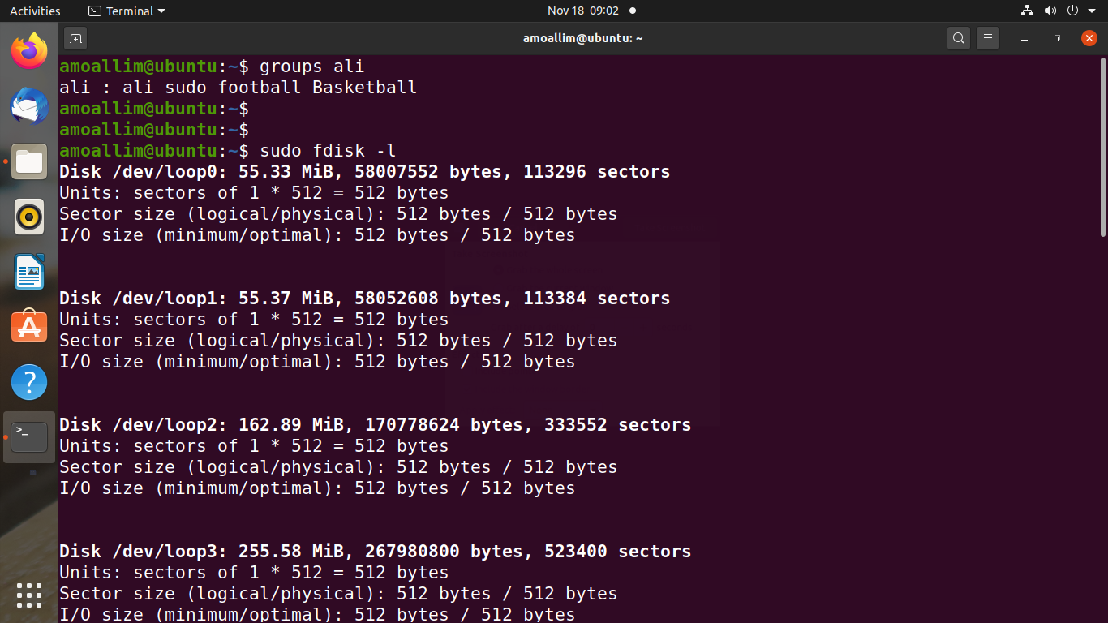
17. Used groups ali to Verify that ali is a member of football basketball and sudo groups
Ali is a user account I created question 12

Slide 16
18 . numeric Permissions to symbolic permissions
Keys:
r = read
w = write
x = execute
-- = no permission
Answers:
a) 666 = rw rw rw
b) 770 = rwx rwx –-
c) 640 = rw r --
d) 444 = r r r
19. I Use fdisk -l to display existing partitions and sizes
look the above picture.

Slide 17
THANK YOU
Abdihamid Mohamed Moallim

